Slide 1
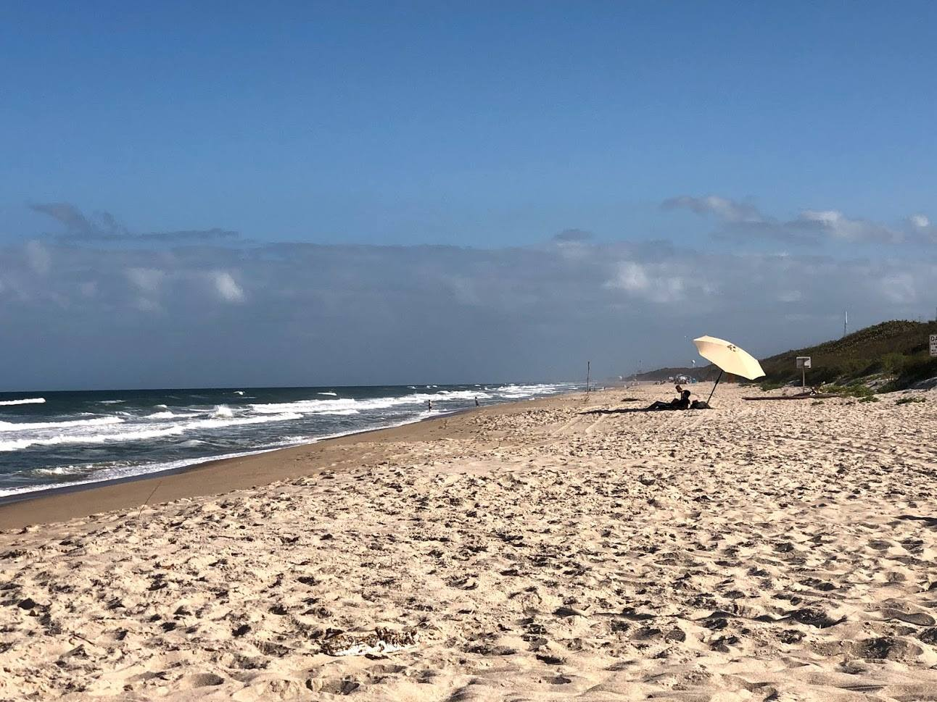
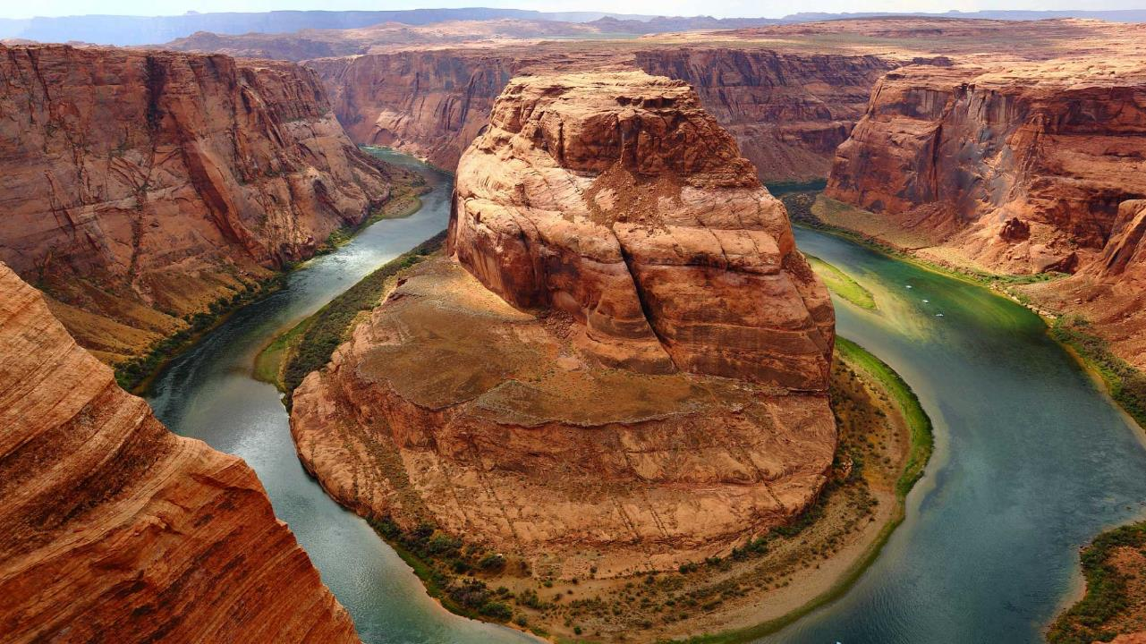
Emerging Media MFA
Animation and Visual Effects track
Orlando Tech Center Suite 500
Notes:
A template for students to design a field trip to a location for other students to view. Includes directions to the student of what to include on each slide and what content should be considered.

Slide 2
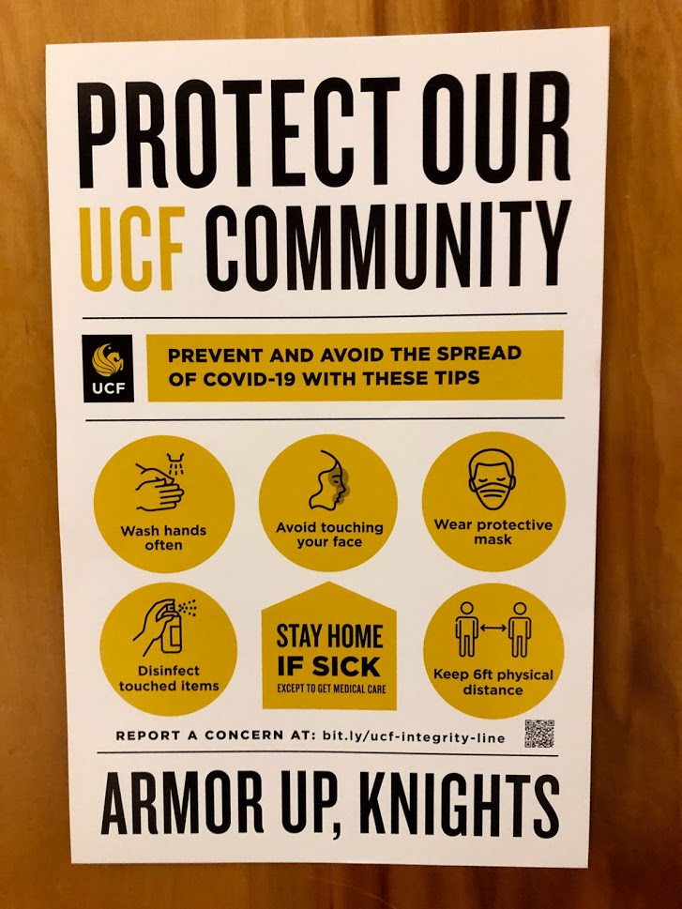
Introductions
Name
Where you are from?
Medium of Choice (2D, 3D, StopMo, etc.)
Favorite relaxing thing to do?

Slide 3
Back to Campus: All students are expected to complete the COVID-19 Student Return to Campus Training in Webcourses@UCF. This training should only take about 10 minutes to complete and shares information about what the return to campus will look like, outlining the policies and guidance each of you is required to follow. On your Webcourses@UCF dashboard, you should see a course card for “COVID-19 Student Return to Campus Training”. Please complete this training before your first day on campus.
COVID Self Checker
Take your Temperature
Wear a Mask
Wash your Hands
Keep 6 feet of distance
Clean and Disinfect workspaces
Cough and Sneeze into your elbow or tissue
Avoid touching face, eyes, nose, and mouth.
DO NOT COME TO CAMPUS OR THE BUILDING IF YOU HAVE BEEN EXPOSED OR ARE SICK.

Slide 4
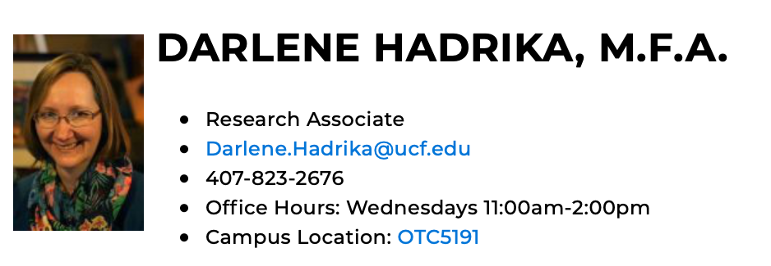
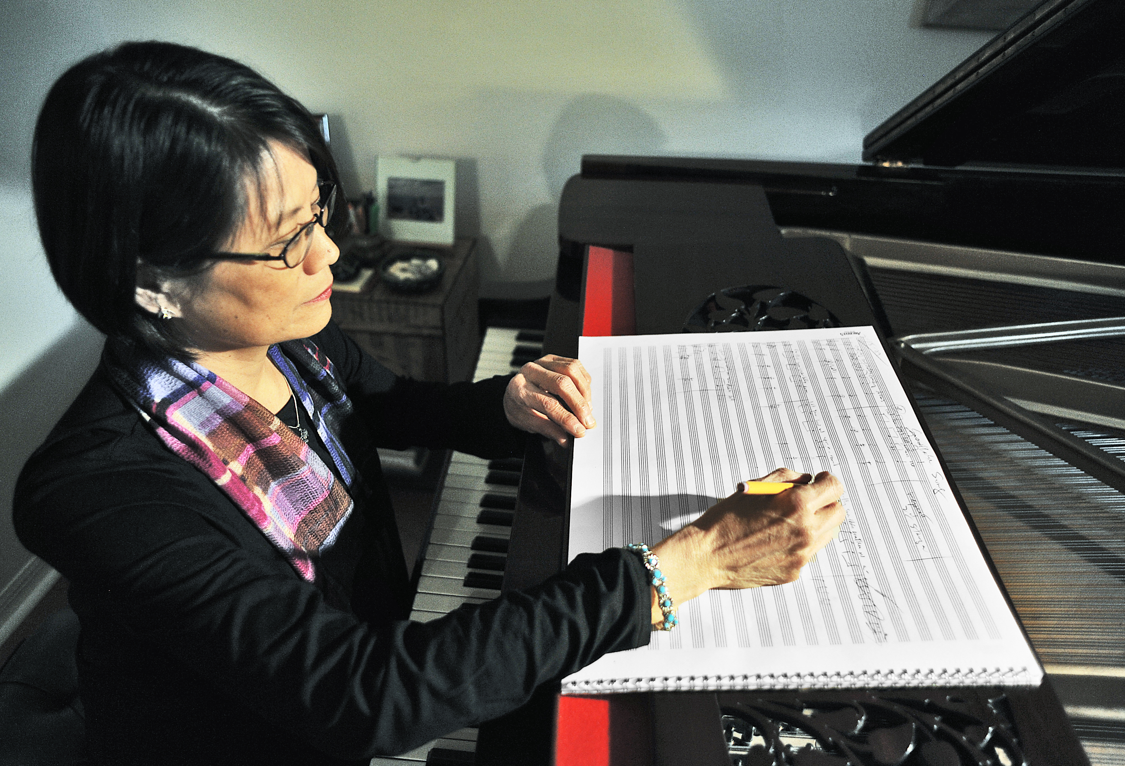
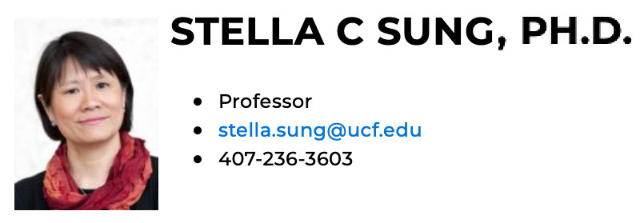
Faculty
https://svad.cah.ucf.edu/faculty-staff/

Slide 5
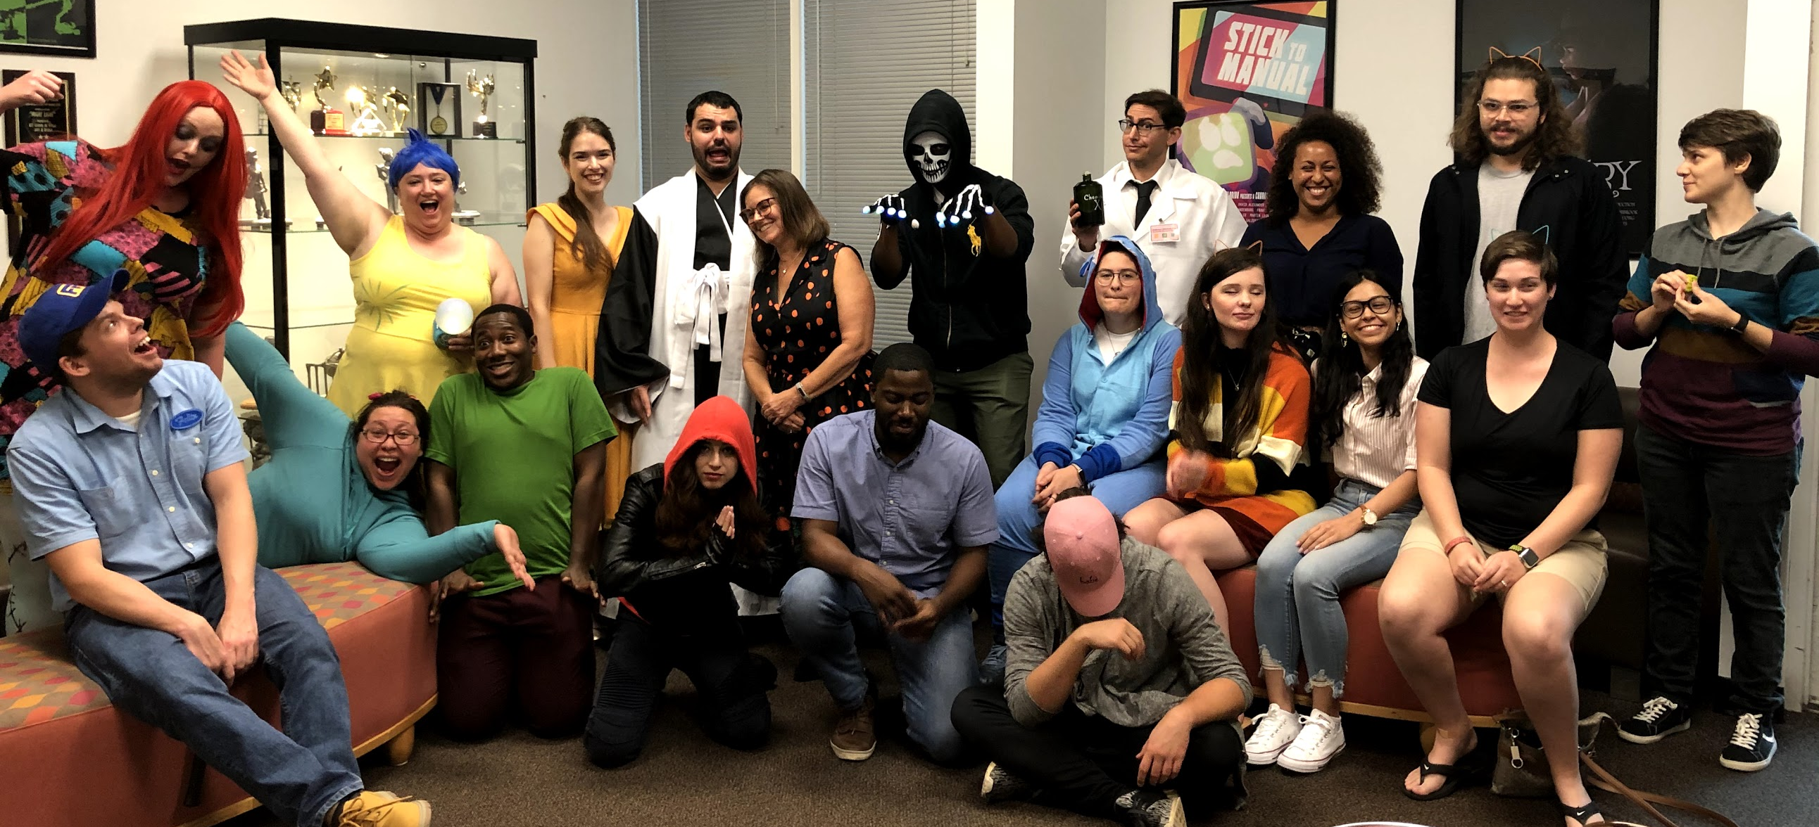
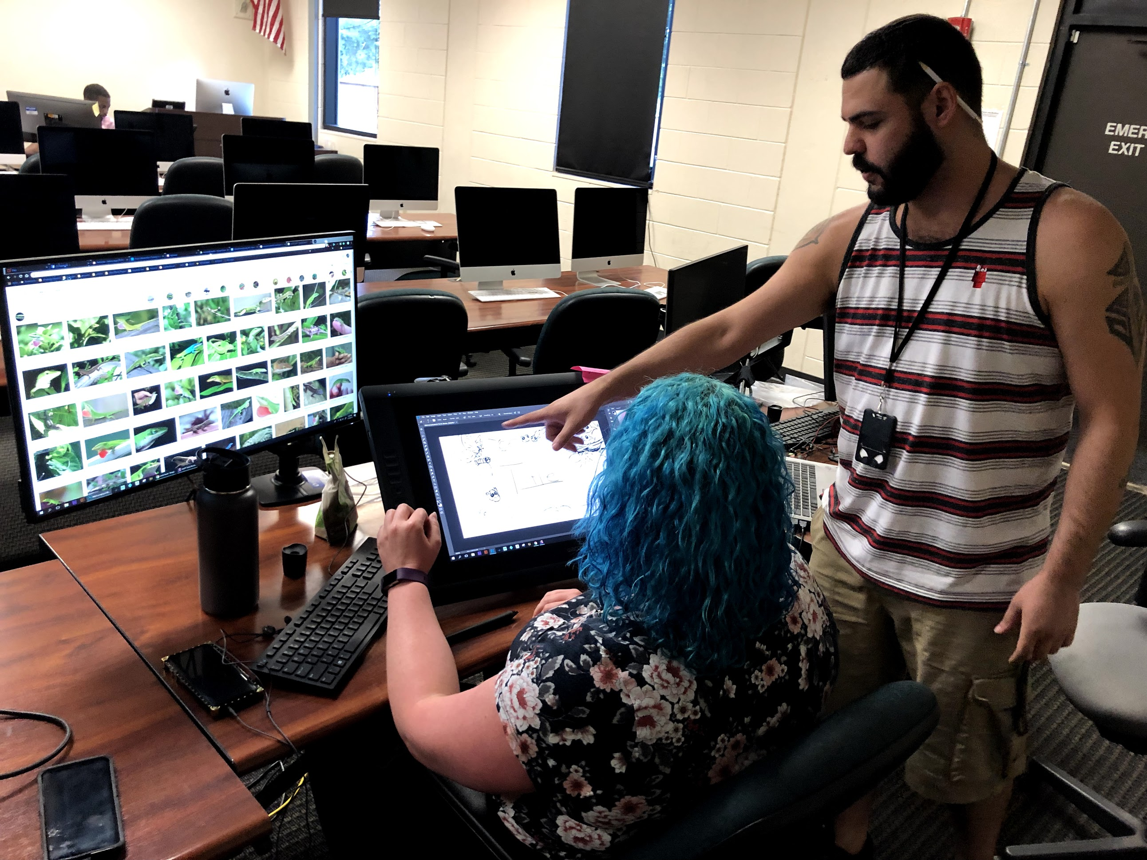
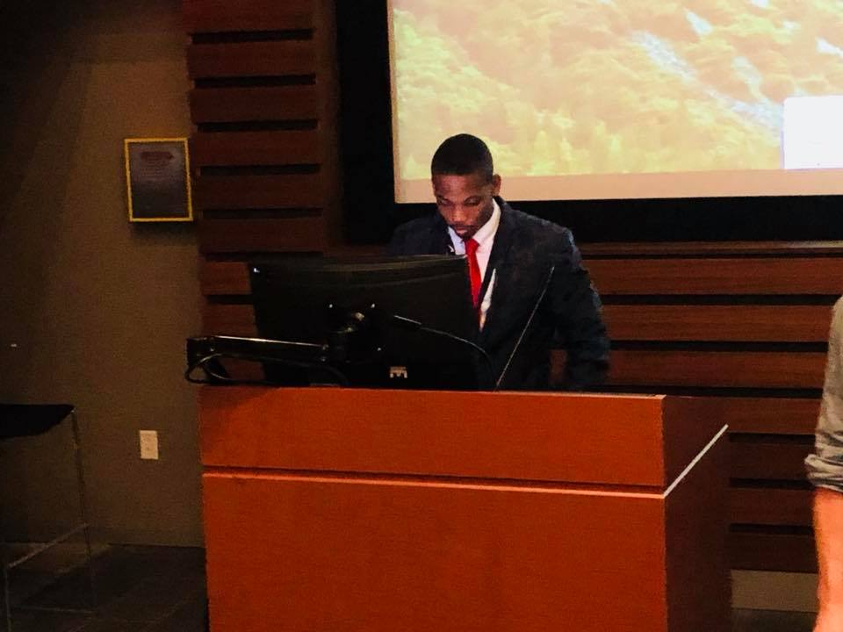
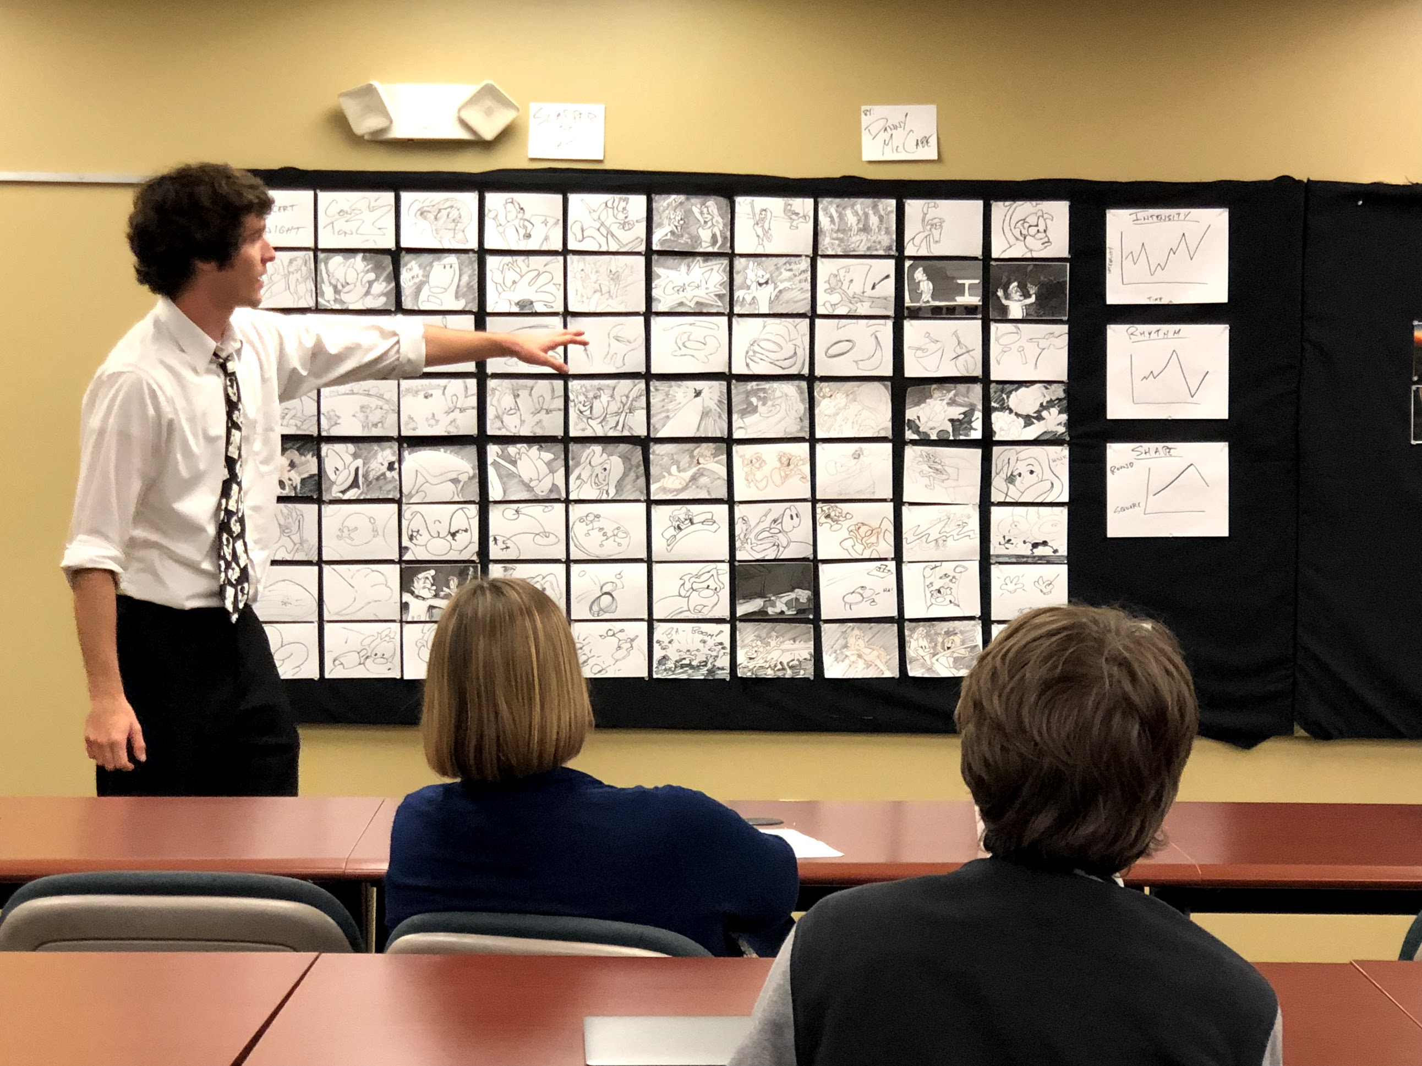
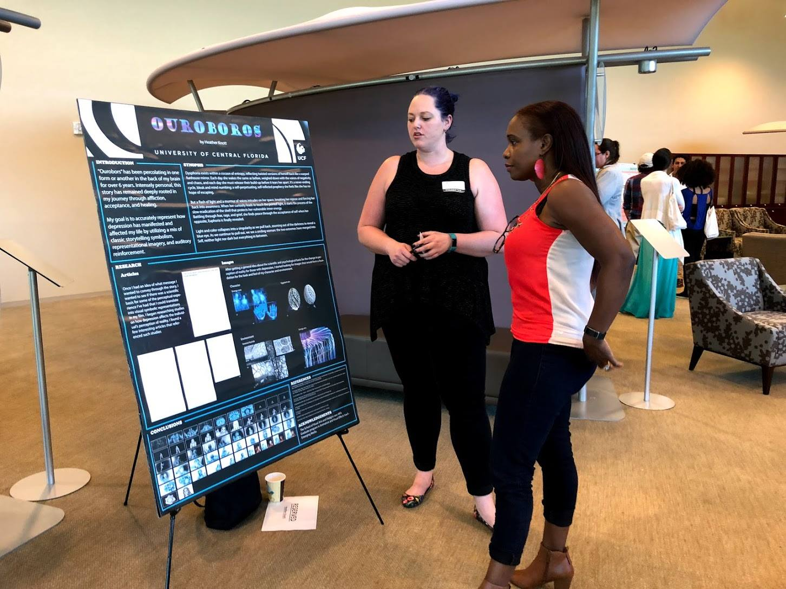
Expectations
Notes:
For example, Astoria Oregon is a town on the Oregon coast well know for its starring role in the movie “The Goonies”. Today, we will take a trip from our school to Astoria through miles and time…

Slide 6
Handbook
https://graduate.ucf.edu/wp-content/uploads/2020/08/Animation-and-Visual-Effects-MFA-2020-2021.pdf
Notes:
For example, Astoria Oregon is a town on the Oregon coast well know for its starring role in the movie “The Goonies”. Today, we will take a trip from our school to Astoria through miles and time…

Slide 7
TITLE
Flow Chart
Circles are holding positions when encountering someone in the hallways. The primary flow is indicated with an arrow. If someone is in the hallway using primary flow, then wait in a holding circle until they pass by.
Use this blank slide to insert a BIG image of the location for your trip.
This slide should capture your fellow students’ interest.
In the notes area, write a terrific lead into the trip you will be taking people on today.
Notes:
For example, Astoria Oregon is a town on the Oregon coast well know for its starring role in the movie “The Goonies”. Today, we will take a trip from our school to Astoria through miles and time…

Slide 8
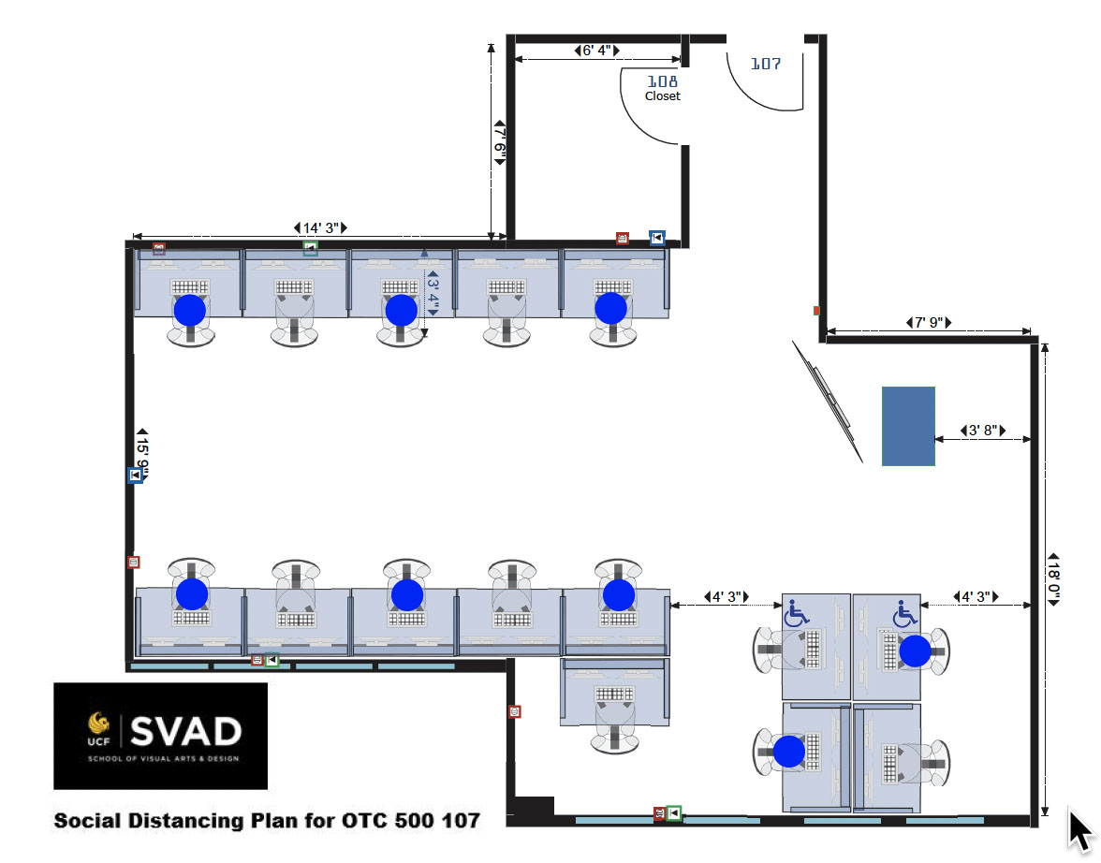
TITLE
Flow Chart
Circles are holding positions when encountering someone in the hallways. The primary flow is indicated with an arrow. If someone is in the hallway using primary flow, then wait in a holding circle until they pass by.
Use this blank slide to insert a BIG image of the location for your trip.
This slide should capture your fellow students’ interest.
In the notes area, write a terrific lead into the trip you will be taking people on today.
Notes:
For example, Astoria Oregon is a town on the Oregon coast well know for its starring role in the movie “The Goonies”. Today, we will take a trip from our school to Astoria through miles and time…

Slide 9
TILE
Cohort #2 (Class of 2021)
and
Cohort #3 (Class of 2022)
Research Space Assignments
2020-2021
Need to fill out Key check out form.
Notes:
For example, Astoria Oregon is a town on the Oregon coast well know for its starring role in the movie “The Goonies”. Today, we will take a trip from our school to Astoria through miles and time…

Slide 10
Program overview

Slide 11
Program overview
Notes:
You can use this type of slide for text, images, shapes and tables to help add information in a different way. Duplicate this slide to add additional images of important location in your visit.

Slide 12
Program overview

Slide 13
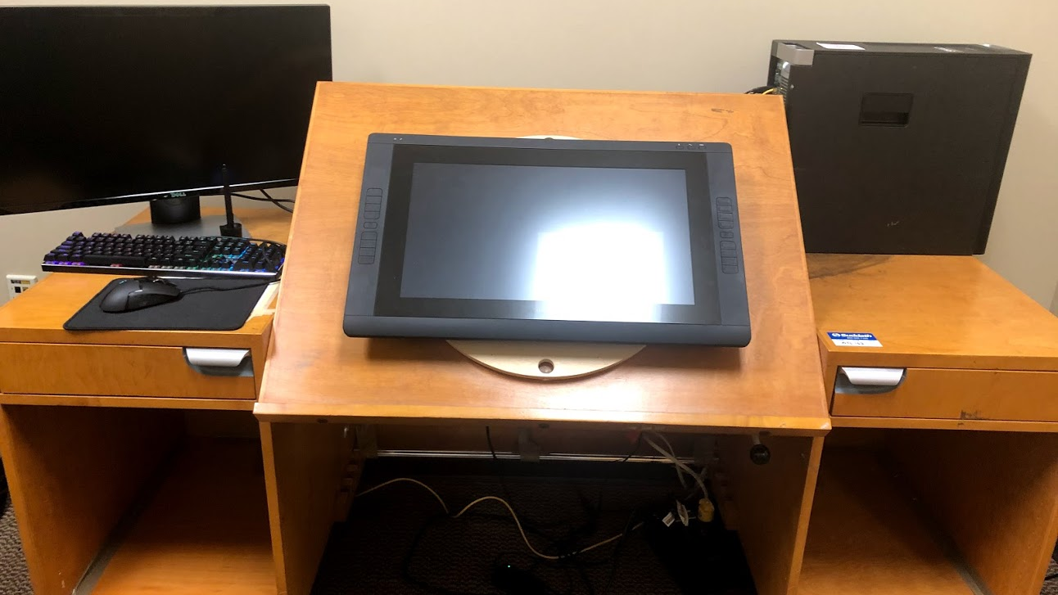
Questions?
ID card numbers send to Cheryl for building access.
https://www.cherylcreates.com/ucf
Virtual Tour to Follow.
GTA meeting after tour.

