Slide 1
School of Visual Arts and Design Graduate Student Orientation

Slide 3
Introductions

Slide 4
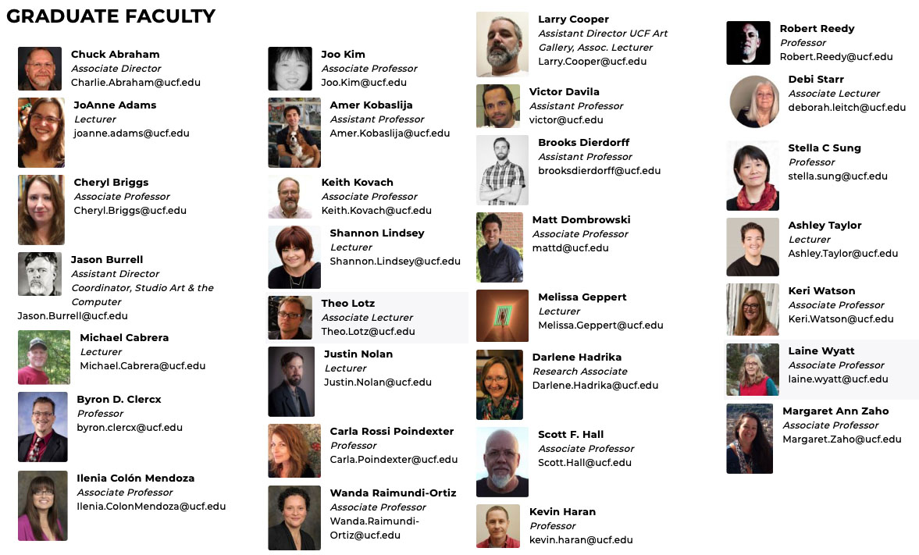

Slide 5
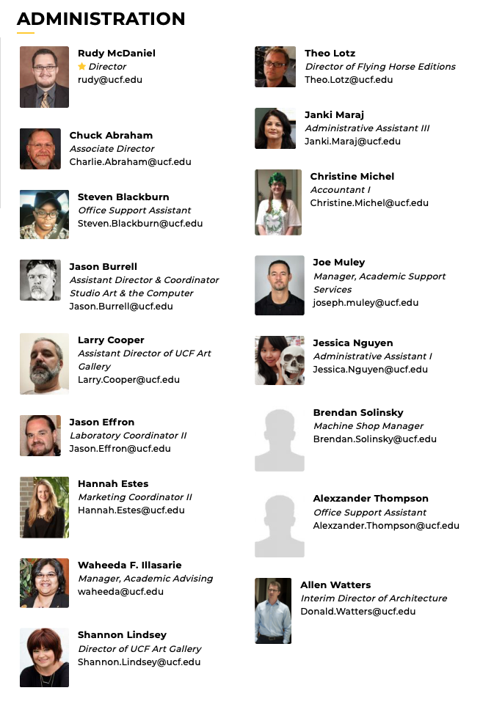

Slide 6
GOALS Emerging Media M.F.A. Animation and Visual Effects emulates the professional studio environment, providing each student with an opportunity to assume an artistic leadership role.

Slide 7
GOALS
Provide students with the experience of the collaborative nature within a commercial animation studio.
Allow students to create or direct their own animation and visual effects.
Develop qualified graduates to enter the teaching and academic professions.
Prepare students with a competitive edge for careers within the animation, visual effects, and simulation industries.

Slide 8
GOALS Emerging Media M.F.A. Studio Art and Design provides opportunities to inform and enhance the artistic practice using 21st Century media.

Slide 9
GOALS
To prepare students for careers as art and design practitioners, scholars and educators in arts ­affiliated fields.
Equipped with profound skills, sensitivity, and sensibility, the UCF School of Visual Arts & Design MFA graduates are poised to become difference ­makers in their artistic disciplines and in schools and communities, as adept and adaptive arts professionals, entrepreneurs, and educators, as well as civic­ minded leaders and citizens.

Slide 10
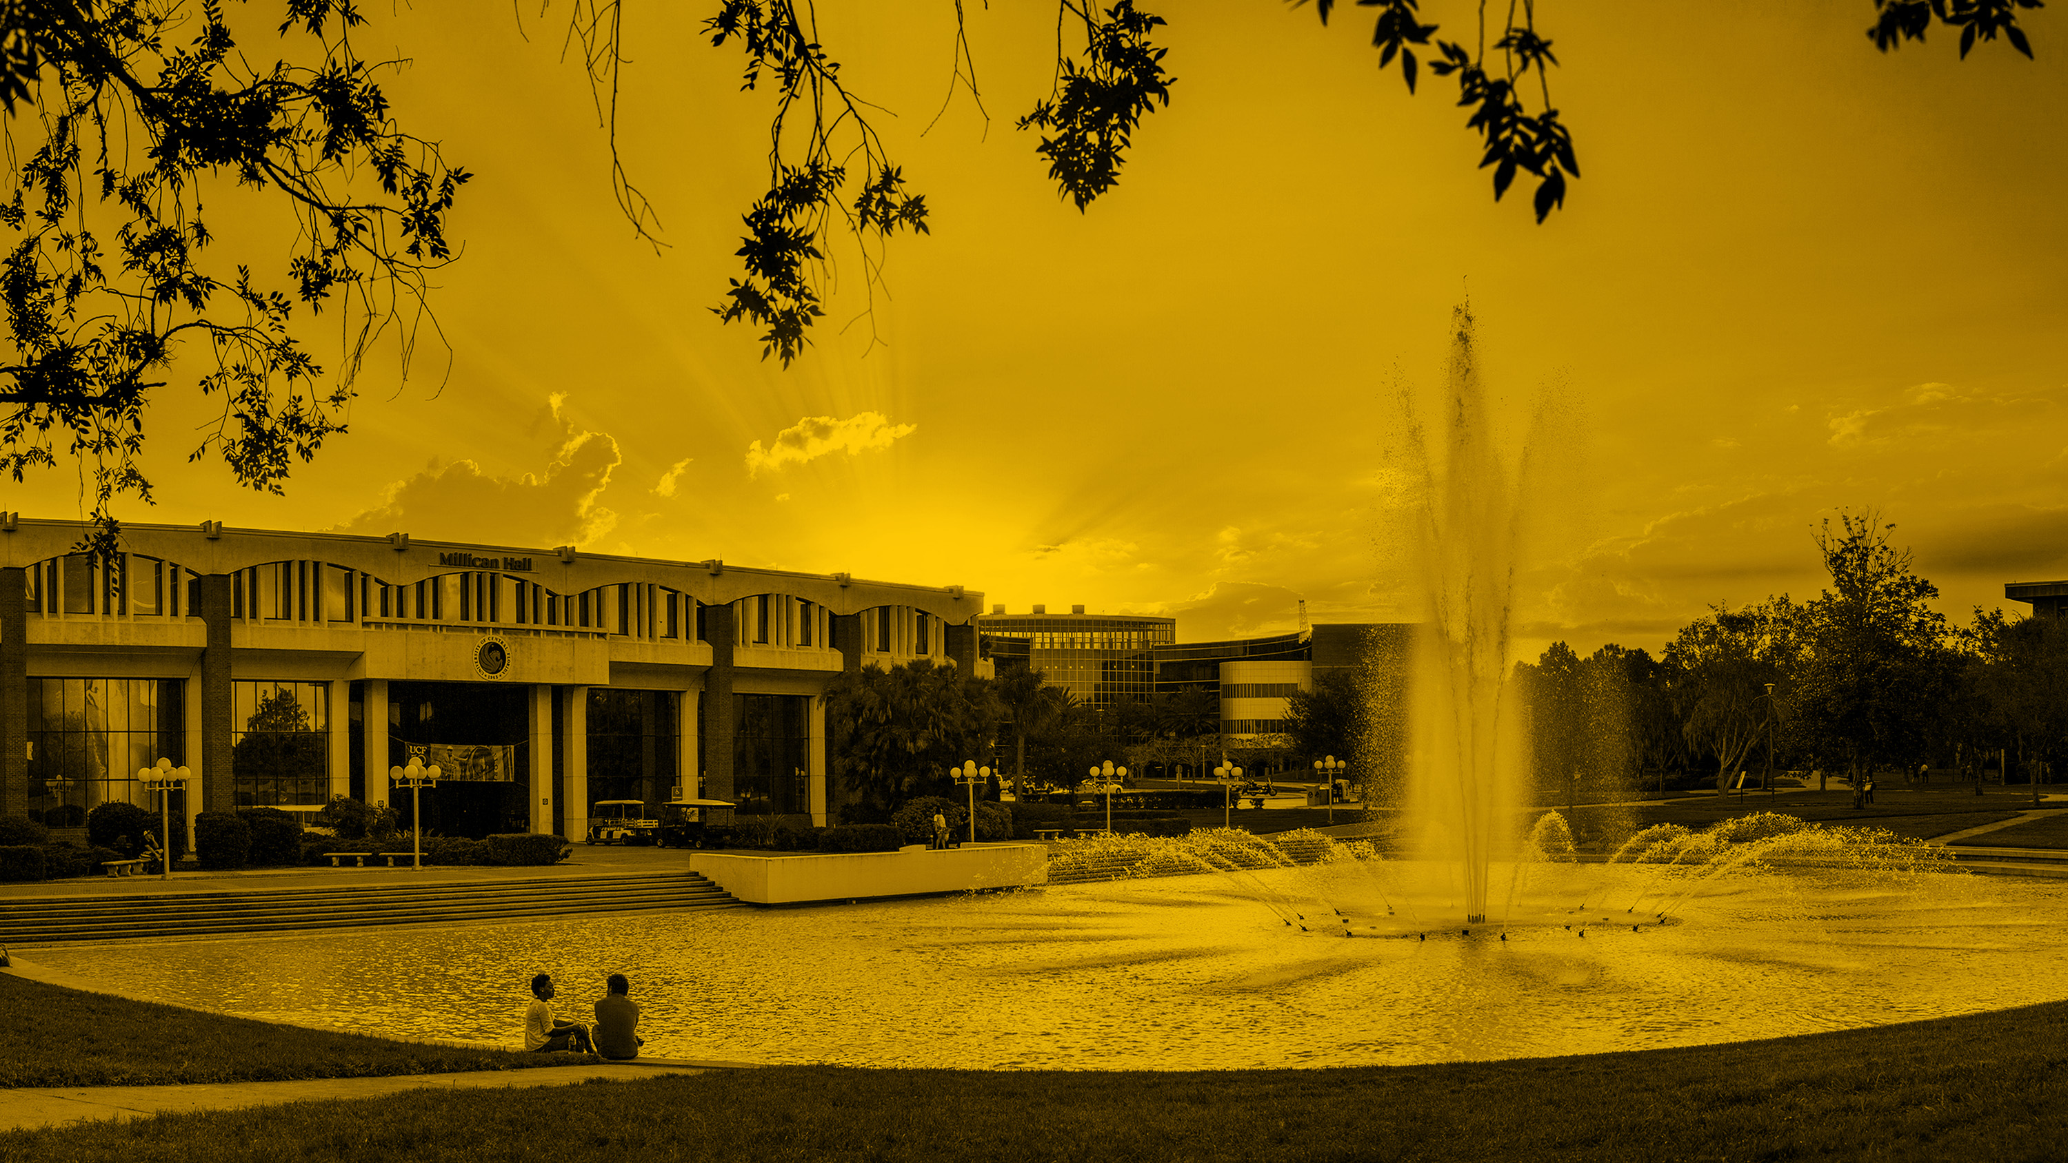
Graduate Program Structure and Information

Slide 11
The Role of the Chair and Mentoring
Thesis Chair must be a graduate faculty.
In the vast majority of cases, the chair is the adviser of the scholarly activities of the student.
A chair of a thesis committee also oversees all of the administrative functions of the committee.
A graduate faculty scholar is not eligible to serve as a chair of a thesis committee.

Slide 12
Administration, Events, Policies, Best Practices
Get organized.
Always be on time with paperwork.
Plan ahead, GPS (Graduate Program of Study).
Look to the future, off campus.

Slide 13
Building Card Access
OTC 650 24/7/365
Code from your UCF ID (send Jason Burrell your 16 digit number for access)
OTC 500 24/7/365
UCF ID Card swipe (send Cheryl Briggs your 16 digit number for access)
Key for some rooms

Slide 14
Proposed Critique Schedule
Mid-term: October 2/9 – Studio Art and Design
October 9 – Animation and Visual Effects
Cohort #3 Benchmark; also schedule meeting with Professor Briggs to discuss potential Thesis Committee
Cohort #4 Schedule a meeting with Professor Briggs for GPS
Final: November 20 – Studio Art and Design
December 4 – Animation and Visual Effects
Cohort #2 Animation and Visual Effects: Thesis Progress
Cohort #4 Animation and Visual Effects: Thesis Project Pitch

Slide 15
Back to Campus: All students are expected to complete the COVID-19 Student Return to Campus Training in Webcourses@UCF. This training should only take about 10 minutes to complete and shares information about what the return to campus will look like, outlining the policies and guidance each of you is required to follow. On your Webcourses@UCF dashboard, you should see a course card for “COVID-19 Student Return to Training”. Please complete this training before your first day on campus.
COVID Self Checker
Take your Temperature
Wear a Mask
Wash your Hands
Keep 6 feet of distance
Clean and Disinfect workspaces
Cough and Sneeze into your elbow or tissue
Avoid touching face, eyes, nose, and mouth.
DO NOT COME TO CAMPUS OR RESEARCH PARK IF YOU HAVE BEEN EXPOSED OR ARE SICK.

Slide 16
Important Dates
https://calendar.ucf.edu/2020/fall
Classes Start Monday, August 24
ACM SIGGRAPH Monday, August 24 through Friday, August 28
Drop /Swap Deadline Thursday, August 27, 11:59pm
Add Deadline Friday, August 28, 11:59pm
Possible Football Closure Friday, September 4
Labor Day Monday, September 7
Graduate Mid-Term Critique Friday, October 2/9
Withdrawal Deadline Friday, October 30
Election Day Tuesday, November 3
Veterans Day Wednesday, November 11
Graduate Final Critique SA Friday, November 20
Last On-Campus Class Tuesday, November 24
Thanksgiving Wednesday, November 25 through Saturday, November 28
Graduate Final Critique AVFX Friday, December 4
Classes End Friday, December 4
Art Basel Miami Possibly Thursday, December 3 through Sunday, December 6
Final Exams Monday, December 7 through Saturday, December 12

Slide 17
Important Dates
https://calendar.ucf.edu/2020/fall
Final day for Thesis committee forms
to be submitted to Graduate Studies: Thu, Aug 20th, 2020
Final day for Graduation Application
for Graduate Students: Sun, Oct 11th, 2020
Graduate Master's Thesis Format
Review Deadline: Fri, Nov 6th, 2020
Graduate Thesis/Dissertation
Defense Deadline: Fri, Nov 20th, 2020
Final Submission Deadline : Fri, Dec 4th, 2020

Slide 18
Important Dates
https://calendar.ucf.edu/2021/spring
Classes Start Monday, January 11
Drop /Swap Deadline Thursday, January 15, 11:59pm
Add Deadline Friday, January 15, 11:59pm
Martin Luther King Jr. Day Monday, January 18
Spring Break Sunday, March 7 through Sunday, March 14
Graduate Mid-Term Critique Friday, March TBA
Withdrawal Deadline Friday, March 25
Graduate Final Critique SA Friday, April TBA
Graduate Final Critique AVFX Friday, April 26
Classes End Friday, April 26
AVFX Premiere UCF CTA or Mon April 26
Study Day Tuesday, April 27
Final Exams Wednesday, April 28 through Tuesday, May 4

Slide 19
Important Dates
https://calendar.ucf.edu/2021/spring
Final day for Graduation Application
for Graduate Students: TBA
Final day for Thesis committee forms
to be submitted to Graduate Studies: Fri, Dec 11th, 2020
Graduate Master's Thesis Format
Review Deadline: TBA
Graduate Thesis/Dissertation
Defense Deadline: TBA
Final Submission Deadline : TBA

Slide 20
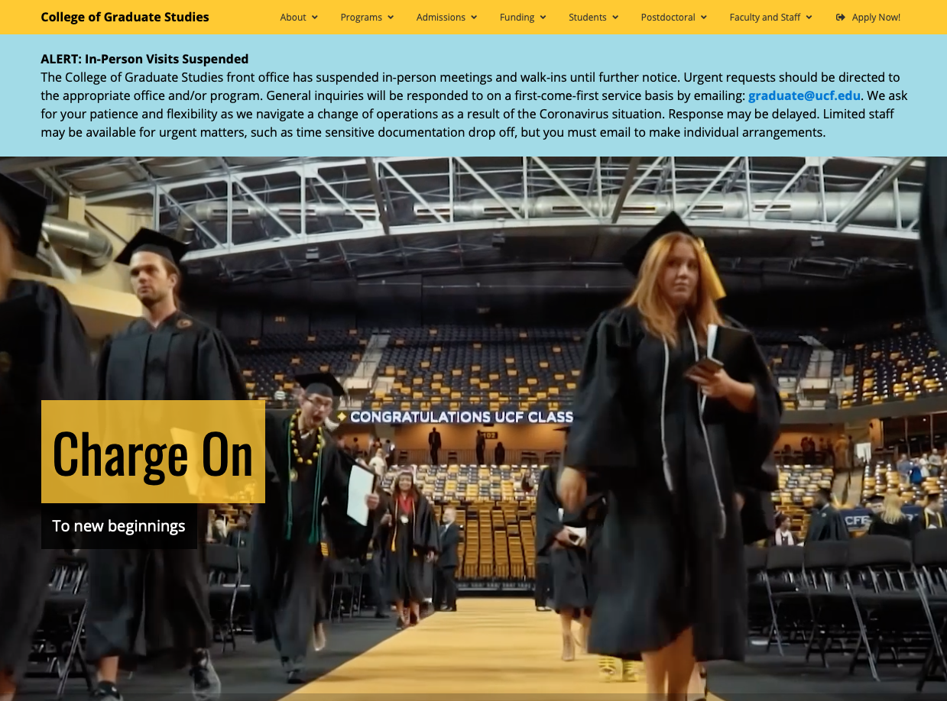
Devon Jensen
Associate Dean

Slide 21
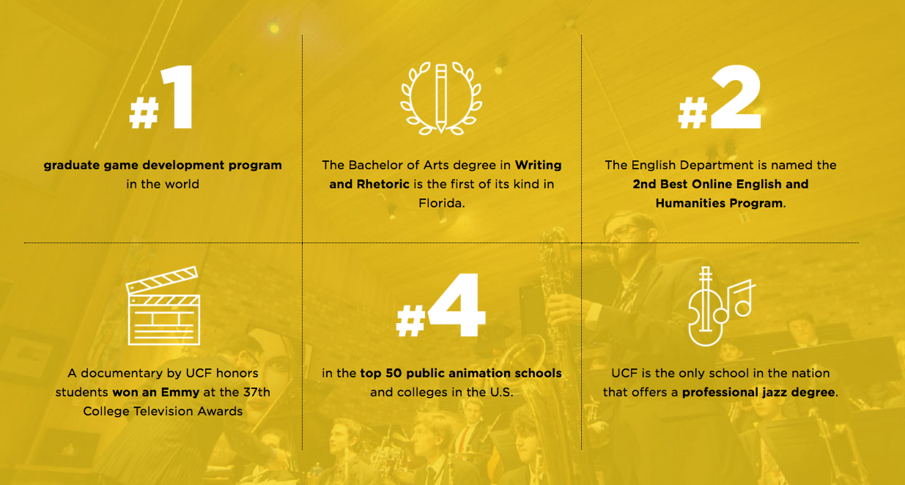
Anastasia Salter
Graduate Director
Carla Grip
Academic Support Services Coordinator

Slide 22
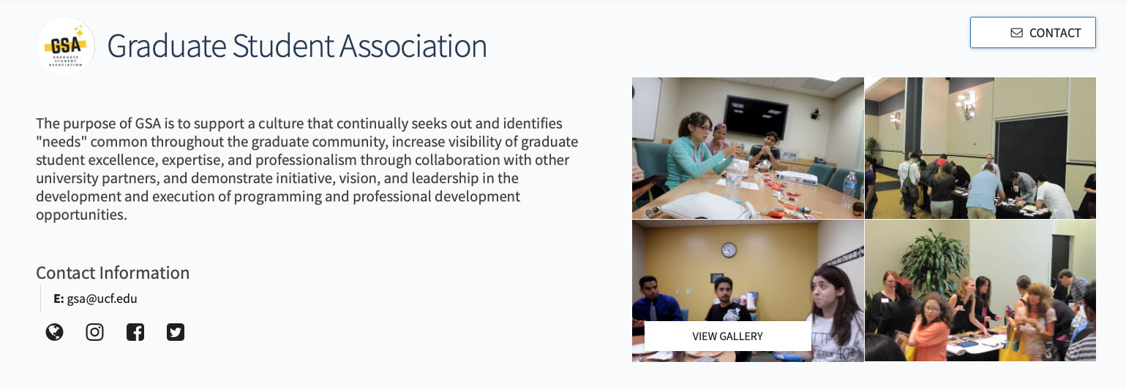

Slide 24
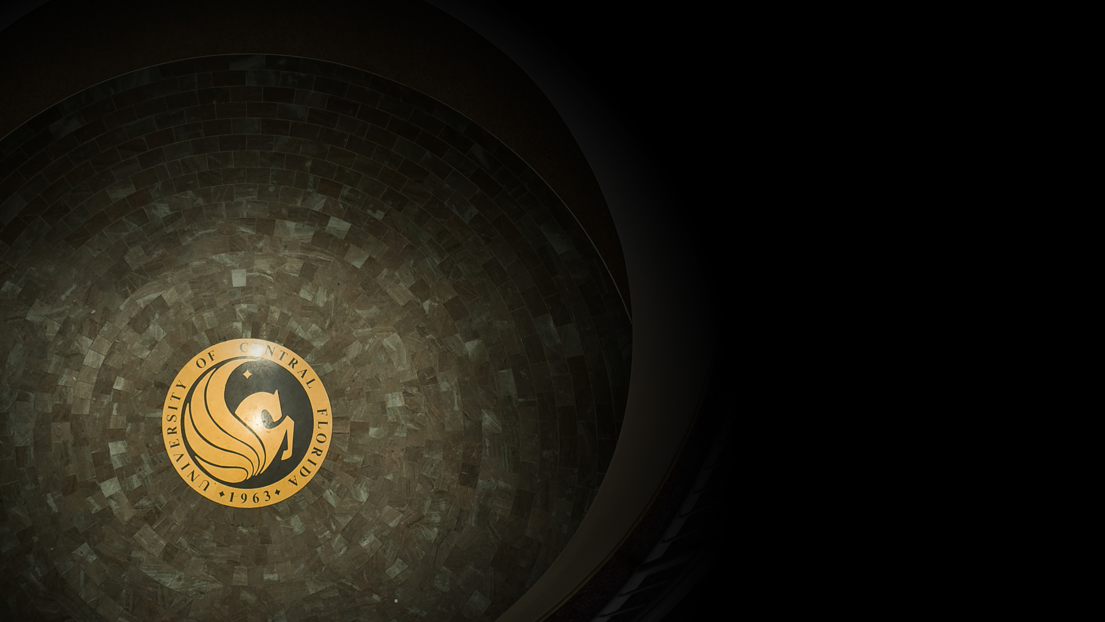
Lunch!

